Slide 1
BUSINESS ASSET RELOCATIONS INC.
Moving
Storage
Recycle
Liquidation
Donation
Services
BAR
Raising the in the Moving Industry

Slide 2
BUSINESS ASSET RELOCATIONS INC.
MOVING
Business Asset Relocation (BAR) is a full-service Relocation firm supporting the needs of the world’s most admired companies in virtually every sector and industry (i.e. retail, publishing, financial services, consumer products, health care, media, airlines, non-profits, and sports venues).
We manage relocations of all sizes and complexities (from small office moves to large scale relocation programs). Whether a business of 10, 50, or 500+ employees, our highly skilled team will transform your organization’s workspace on-time, on-budget and on-scope.

Slide 3
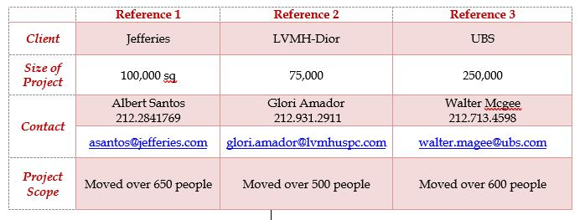
BUSINESS ASSET RELOCATIONS INC.
MOVE REFERENCES

Slide 4
BUSINESS ASSET RELOCATIONS INC.
STORAGE
Located conveniently in Newark, NJ, our storage facility boasts more than 70,000 square feet of state-of-the-art, fully secured, storage space.
We utilize the most advanced inventory tracking management system.
Using our web-based information system, our clients have access to their inventory online, 24/7.
The system allows our clients to instantly pull up a full inventory of all their products or just one specific item.
Our warehouse is available for both long and short-term storage needs and our space is designed to handle daily deliveries, both large and small.

Slide 5
BUSINESS ASSET RELOCATIONS INC.
LIQUIDATION
We are a full service liquidation firm:
We develop a full schedule working back from your lease termination date
We arrange for all client direct donations first
We coordinate with your electrician to make sure all power is cut and capped before furniture is knocked down
We can provide e-waste services
We knock down and remove all furniture
We complete a broom sweep of your space so it can be turned over in good condition in a timely manner
All furniture that is not sold or donated is recycled in accordance with the green standard

Slide 6
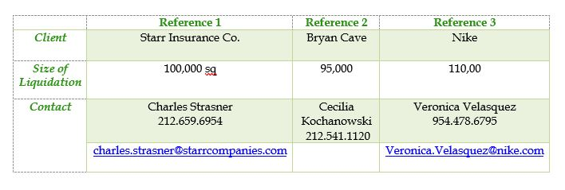
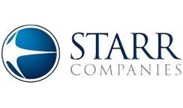
BUSINESS ASSET RELOCATIONS INC.
LIQUIDATION REFERNCES

Slide 7
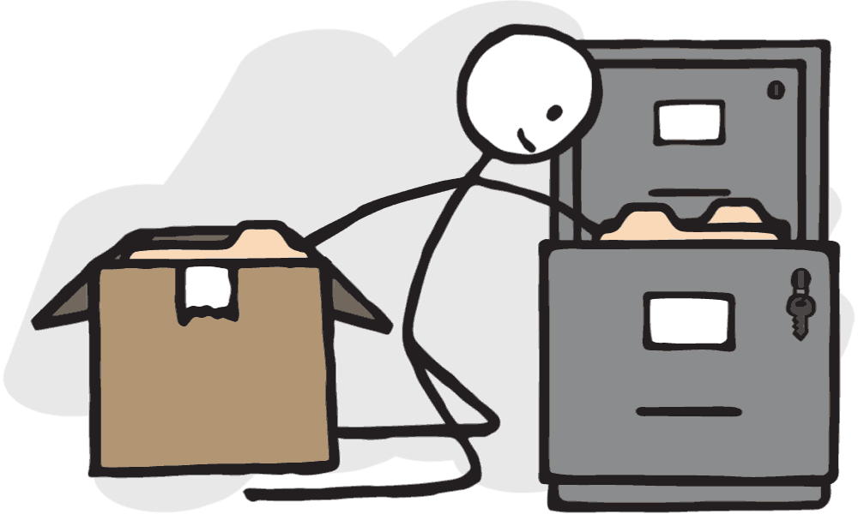
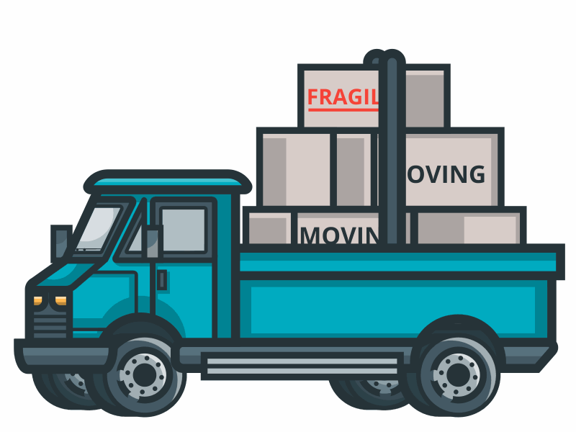
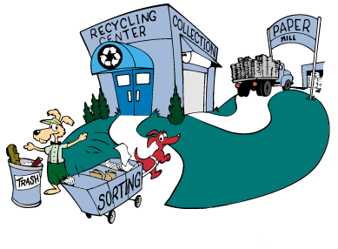
BUSINESS ASSET RELOCATIONS INC.
SERVICES
Moving
Storage
Liquidation
E-Waste
Carpentry
Safe Shredding
Purge Campaign
Donation
Furniture Cleaning
Warehouse Receive & Deliver
Pre-Assembly @ Warehouse
Online Warehouse Inventory

Slide 8
BUSINESS ASSET RELOCATIONS INC.
DONATION
We are committed to giving back to the communities in which we live and work and do so in a number of ways:
Once materials are liquidated from a client site and are of reusable quality, BAR immediately matches it with the needs of a partner charity or non-profit organization.
We also donate our services to those in need, such as City Harvest. We have provided trucks and drivers to help collect and deliver food.

Slide 9
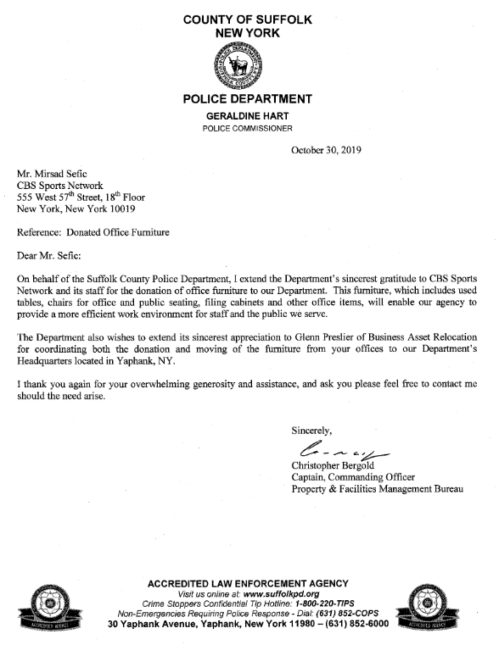
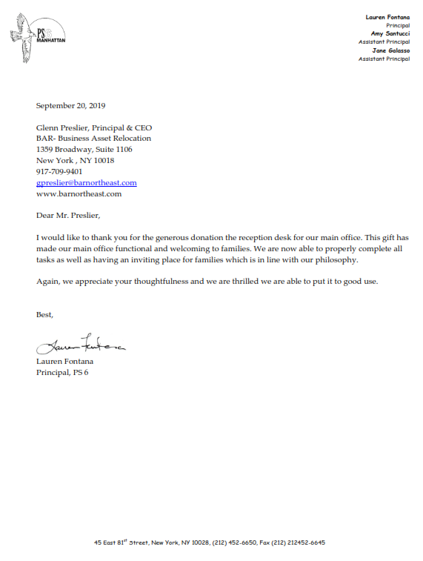
BUSINESS ASSET RELOCATIONS INC.
DONATION

Slide 10
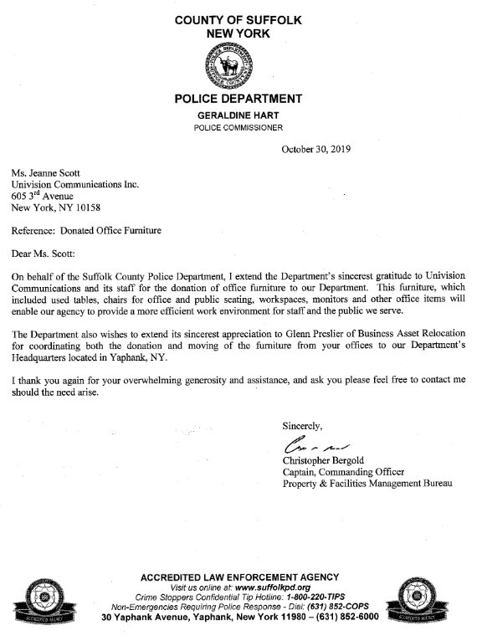
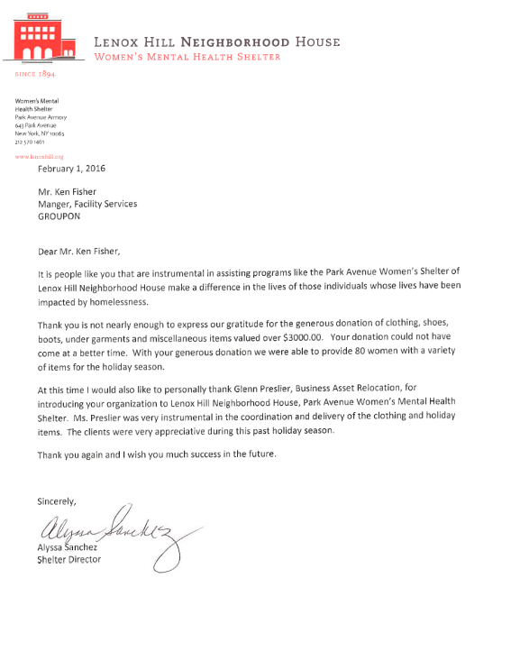
BUSINESS ASSET RELOCATIONS INC.
DONATION

Slide 11
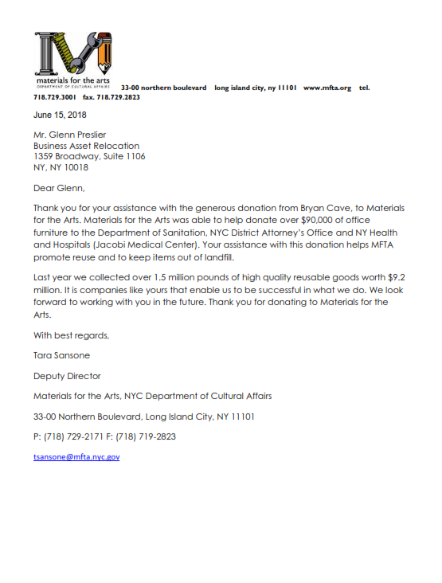
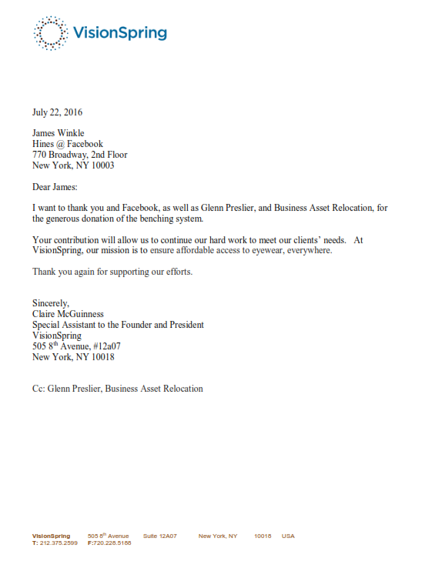
BUSINESS ASSET RELOCATIONS INC.
DONATION

Slide 12
BUSINESS ASSET RELOCATIONS INC.
RECYCLE
We are strongly committed to driving environmental sustainability by adhering to a strict Green Code of ethics.
Materials removed from a client site that are deemed unsuitable to donate but are recyclable are delivered to a local recycling facility.
Your organization can have peace of mind knowing its relocation or liquidation is actually supporting green initiatives.
Once there, it is then re-purposed in many
ways that benefit our environment.

Slide 13
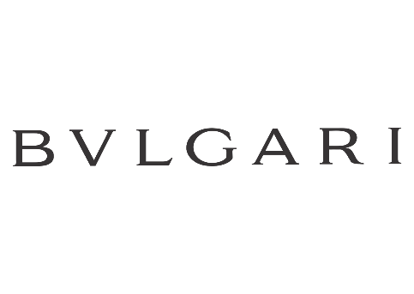
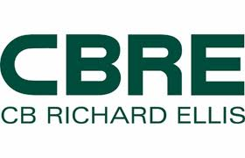
BUSINESS ASSET RELOCATIONS INC.
NOTABLE CLIENTS

Slide 14
Business Asset Relocations Inc. 1359 Broadway, Suite 1106, New York, NY 10018 BAR Storage Inc 16 Herbert Street, Newark, NJ 07105 212-244-6677 Tel 212-244-6626 Fax www.barnortheast.com
BUSINESS ASSET RELOCATIONS INC.
Glenn Preslier, Principal & CEO – gpreslier@barnortheast.com
Kevin Murray, COO – kmurray@barnortheast.com

Slide 15
BUSINESS ASSET RELOCATIONS INC.
Moving
Storage
Recycle
Liquidation
Donation
Services
BAR
Raising the in the Moving Industry

